Slide 1
Report on Popular diagnostic Center Analysis
Prepared by Shakil Ahammed

Slide 2

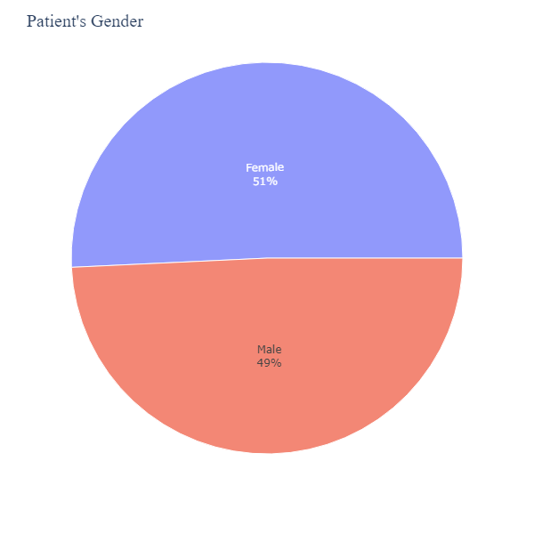
Patient’s Gender:
Females make up 51% of the patients.
Males make up 49% of the patients.

Slide 3
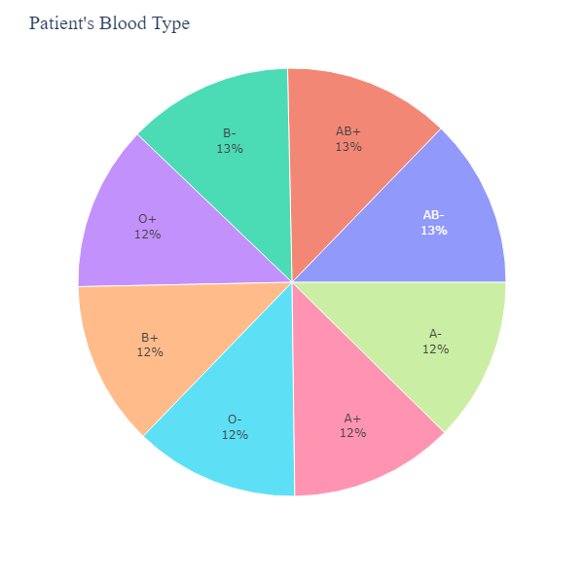
Patient’s Blood Type:
B- 13%
AB+ 13%
A- 12%
B+ 12%
0- 12%
A+ 12%

Slide 4
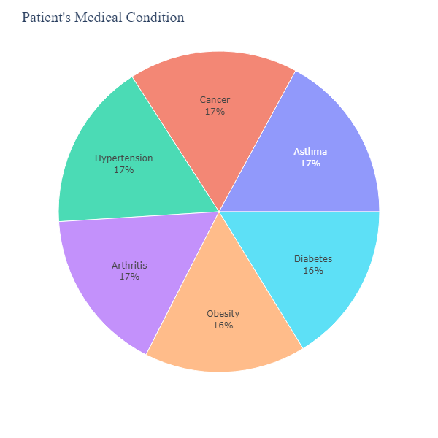
Patient’s Medical Condition:
Cancer: 17%
Hypertension: 17%
Asthma: 17%
Arthritis: 10%
Diabetes: 10%
Obesity: 16%

Slide 5
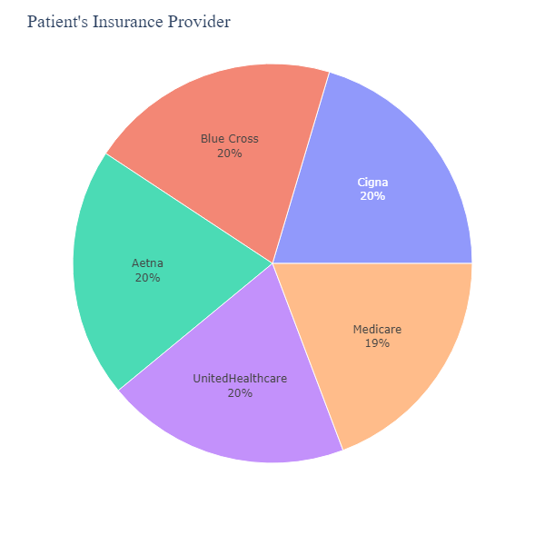
Patient’s Insurance Provider:
Blue Cross: 20%
Cigna: 20%
Aetna: 20%
Medicare: 19%
UnitedHealthcare: 20%

Slide 6
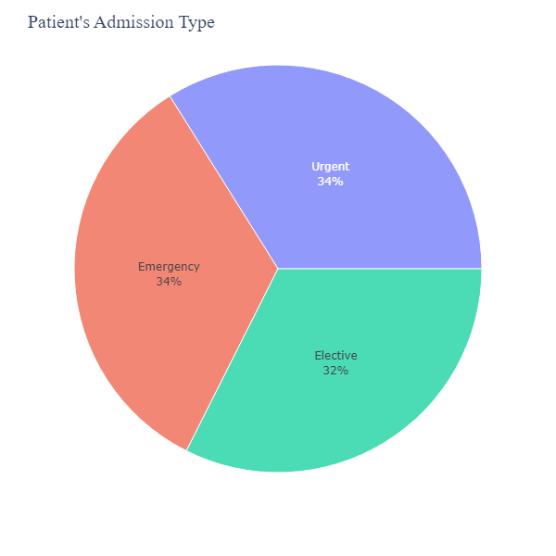
Patient’s Admission Type:
Emergency: 34%
Urgent: 34%
Elective: 32%

Slide 7
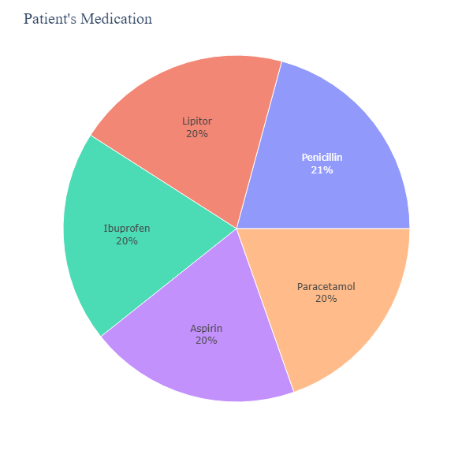
Patient’s Medication:
Ibuprofen: 20%
Penicillin: 21%
Lipitor: 20%
Aspirin: 20%
Paracetamol: 20%

Slide 8
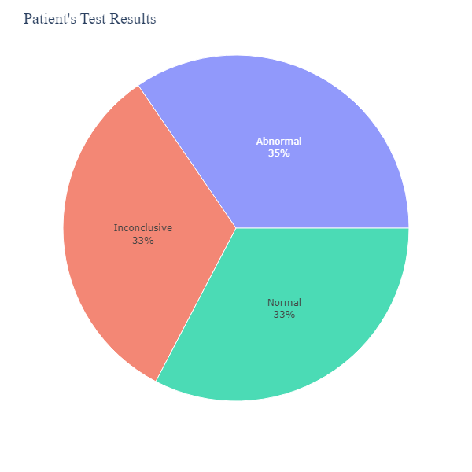
Patient’s Test Result:
Normal: 33%
Inconclusive: 33%
Abnormal: 35%

Slide 9
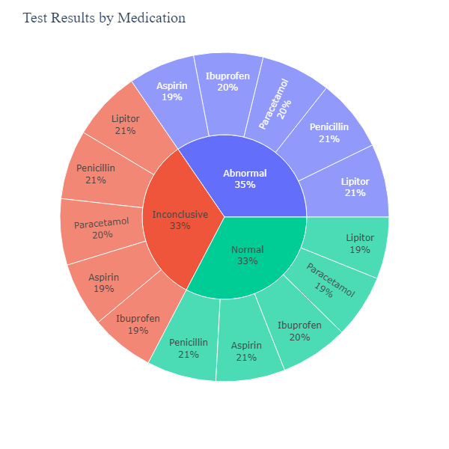

Slide 10
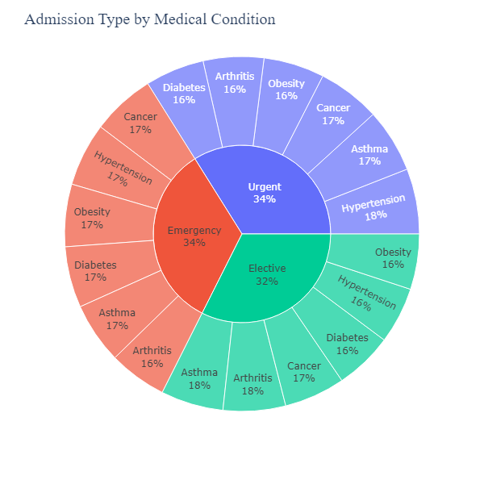

Slide 11
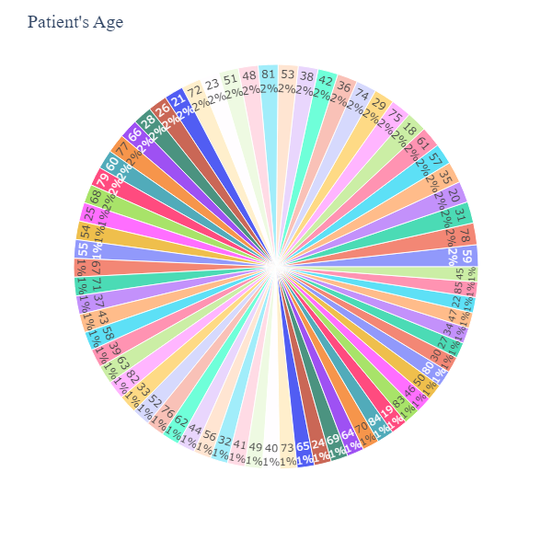

Slide 12
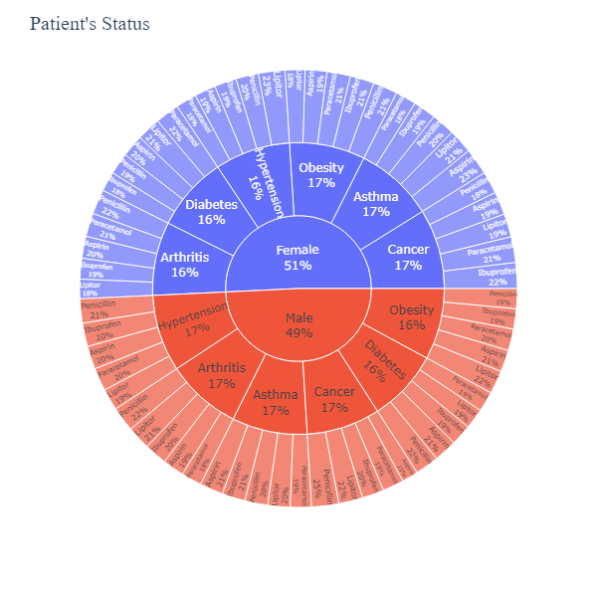

Slide 13
Conclusion
The diagnostic center treats a wide range of medical conditions, with a focus on chronic conditions like hypertension, arthritis, and diabetes.
There may be a higher prevalence of these chronic conditions in the population served by the diagnostic center.
The pie chart doesn't reveal any underlying causes for these conditions, but it suggests that the center might benefit from specializing in these areas.
Penicillin, ibuprofen, Lipitor, paracetamol, and aspirin are the most commonly prescribed medications, likely because they target a variety of these chronic conditions.

